Slide 1
IAM User creation IN AWS

Slide 2
An IAM (Identity and Access Management) user in AWS is an entity that represents a person or an application that interacts with AWS services. It consists of credentials (username, password, and/or access keys) and permissions defined by IAM policies.

Slide 3
Key features of IAM user User Creation – IAM users are created within an AWS account and assigned specific permissions. Authentication – Users can log in using a password (for console access) or use access keys (for programmatic access). Permissions – Access is controlled using IAM policies, which define what actions a user can perform. Groups – IAM users can be part of IAM groups to inherit permissions. Roles – Instead of assigning permissions directly, users can assume IAM roles for specific tasks. MFA (Multi-Factor Authentication) – Enhances security by requiring a second authentication factor.

Slide 4
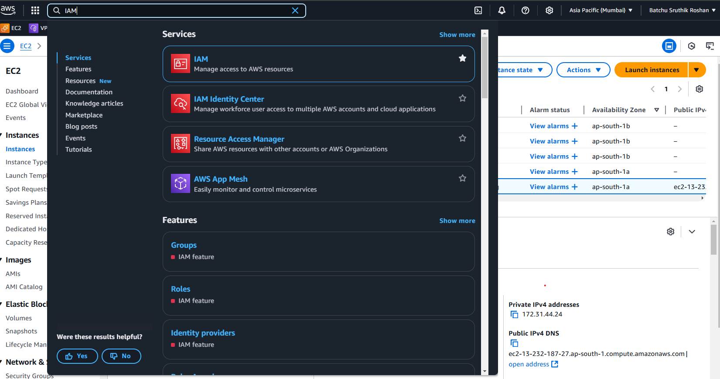
Step 1: Sign in to AWS Management Console Go to the AWS Management Console: https://aws.amazon.com/console/ Navigate to the IAM (Identity and Access Management) service.

Slide 5
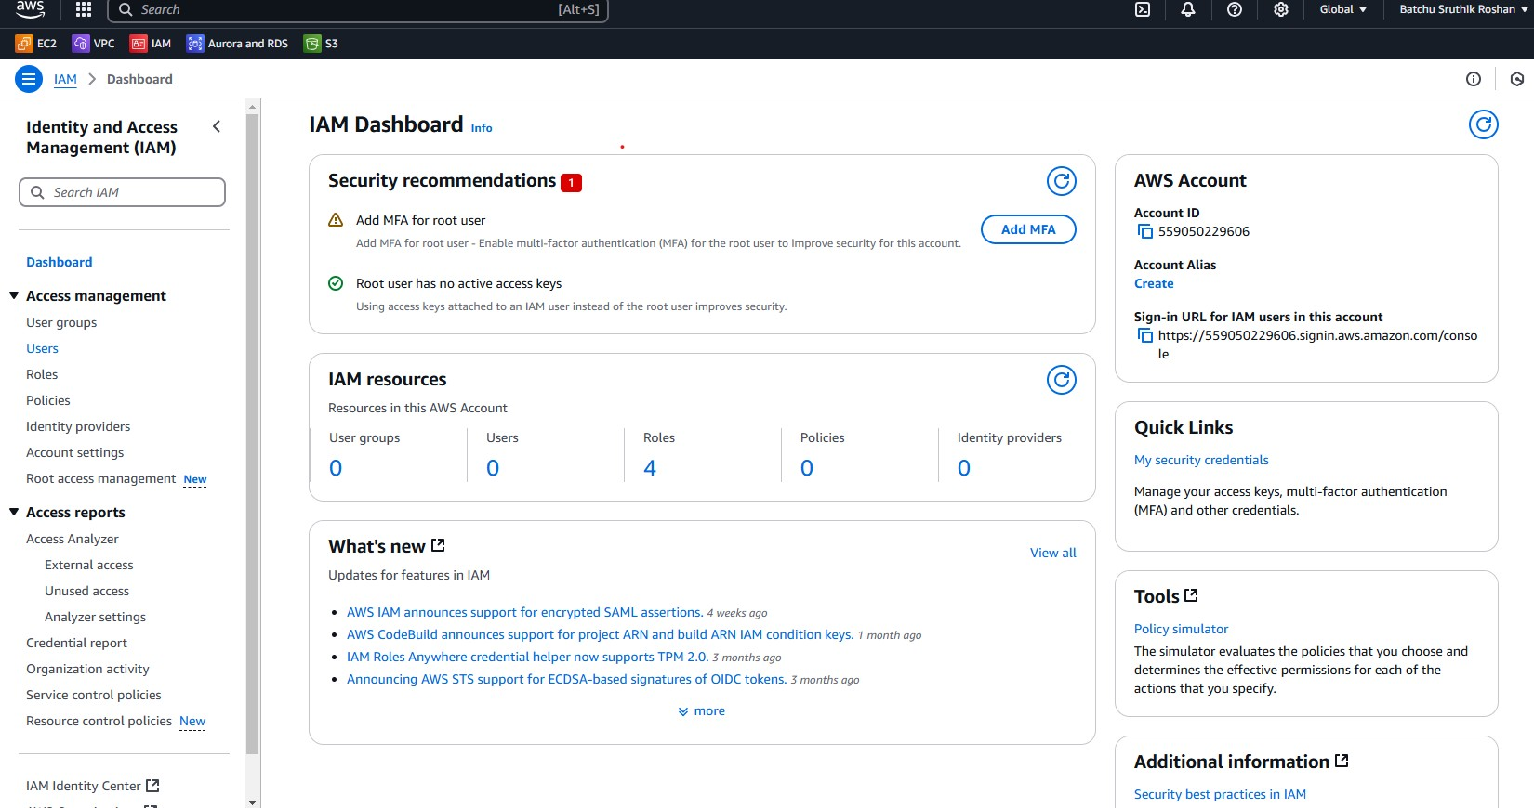
Step 2 : Navigate to Users 1. In the IAM dashboard, click "Users" in the left sidebar. 2. Click the "Add users" button.

Slide 6
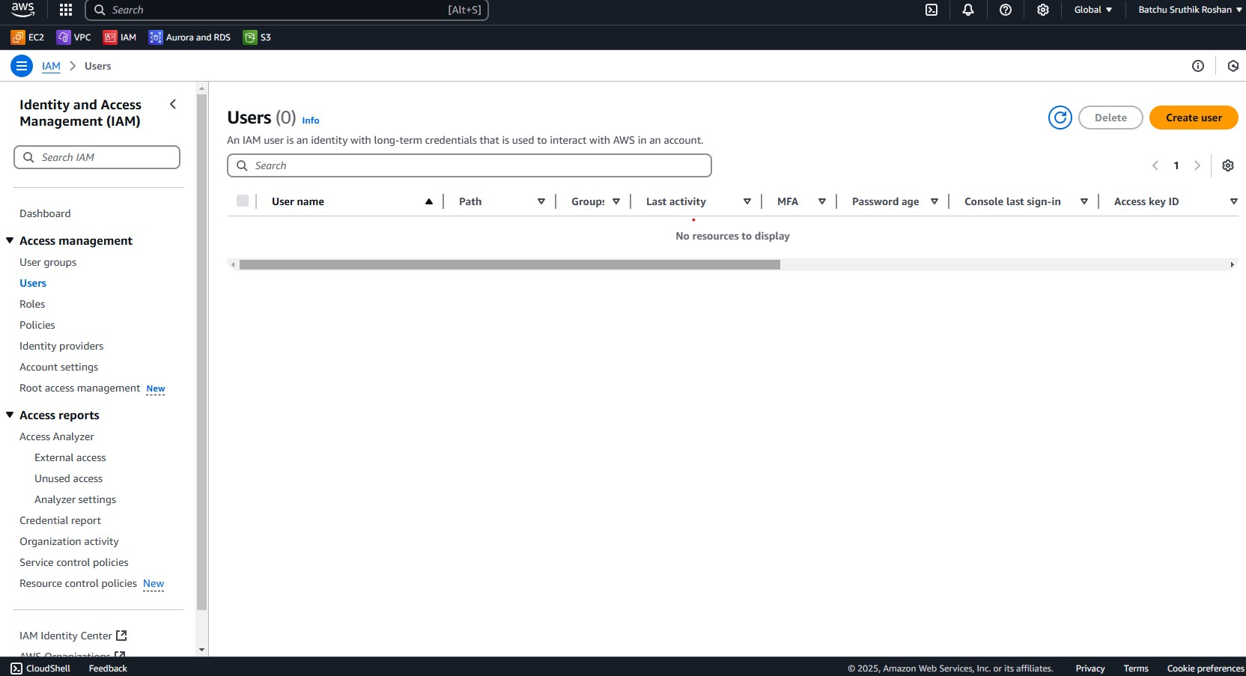
Step 3: Configure User Details 1. User Name – Enter the username (e.g., Ascus_aws). 2. Access Type – Choose how the user will access AWS: AWS Management Console access (for GUI access) → Set a password. Programmatic access (for CLI, SDK, or API access) → Generates an access key and secret key

Slide 7
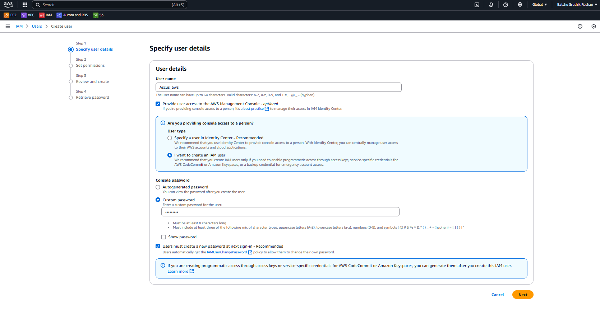

Slide 8
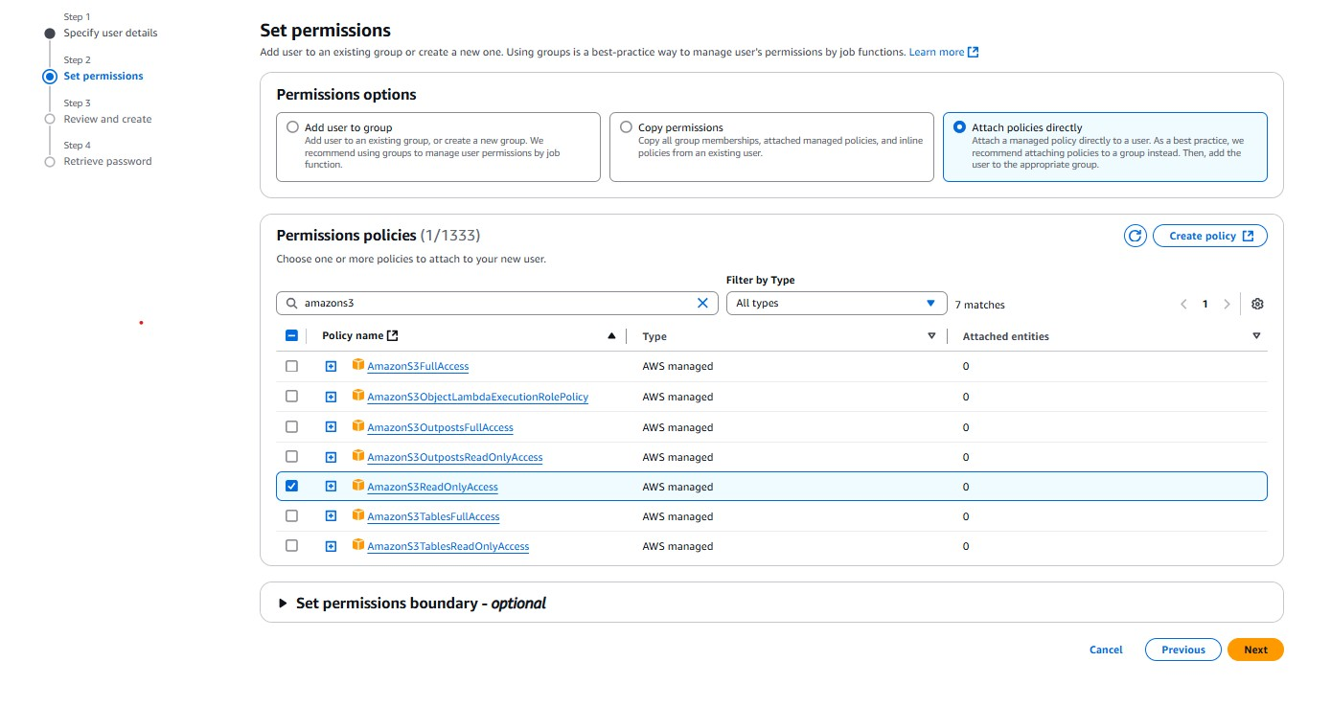
Step 4: Set Permissions Choose how to assign permissions: 1. Add user to a group – Use IAM groups with predefined policies. 2. Attach policies directly – Select specific AWS-managed or custom policies (e.g., AmazonS3ReadOnlyAccess).

Slide 9
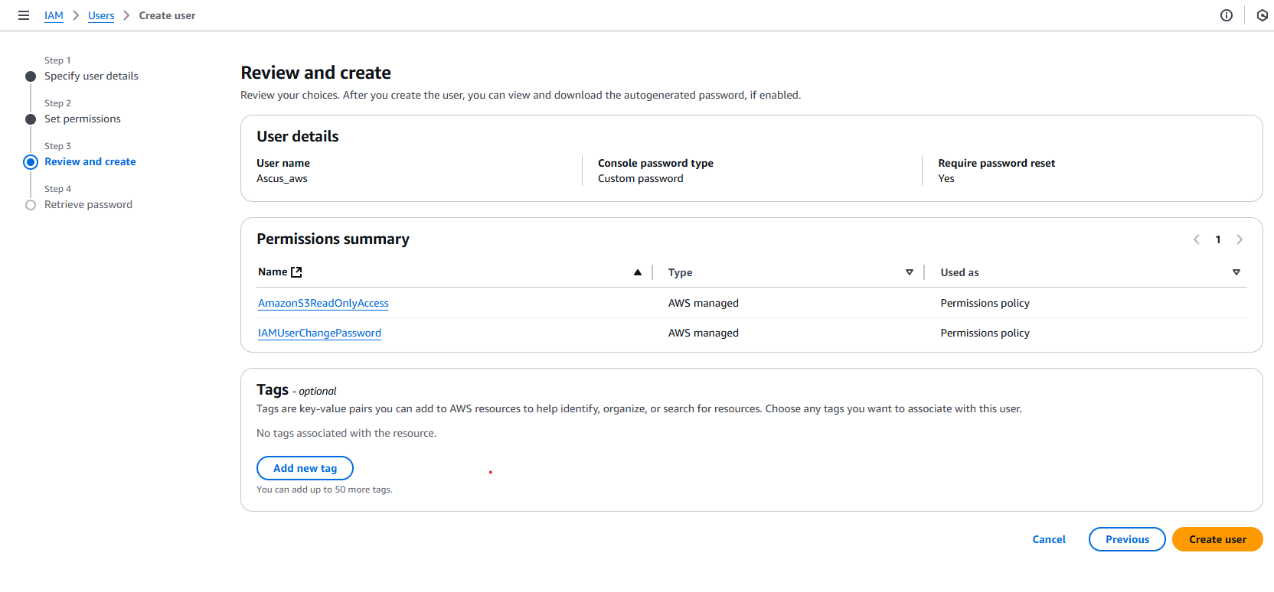
Step 5 : Review and Create User 1. Review the details and permissions. 2. Click "Create user".

Slide 10
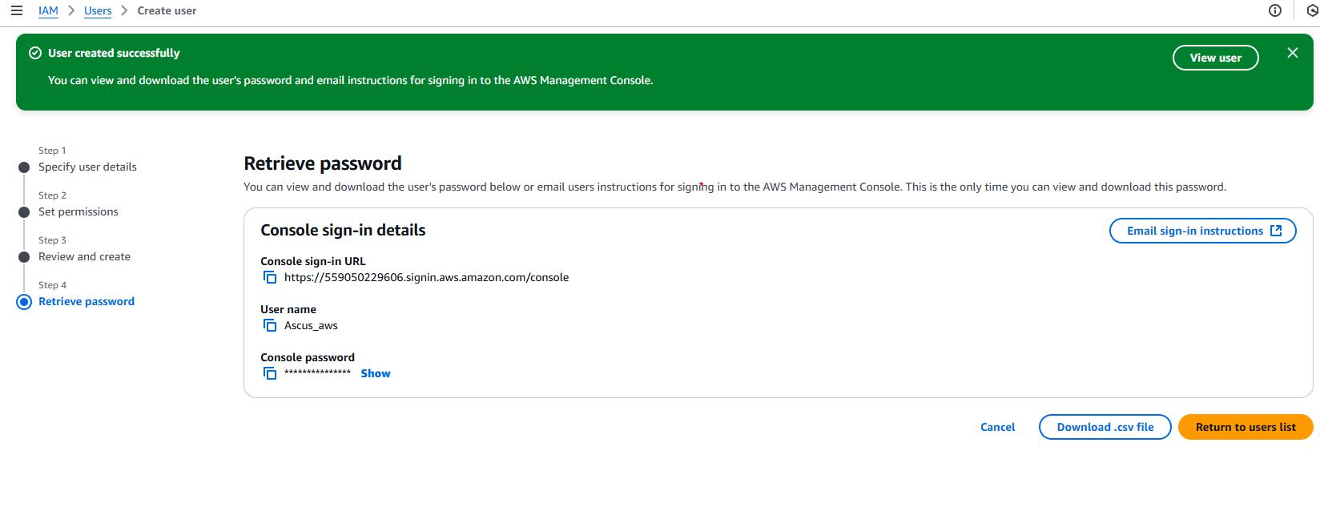
Step 7: Download Credentials 1. If programmatic access was enabled, download the .csv file containing: Access Key ID Secret Access Key (needed for AWS CLI & SDK access) 2. Important: The secret key will not be shown again—store it securely

